Slide 1
Interest Rates Prediction for Beginning of 2025

Slide 2
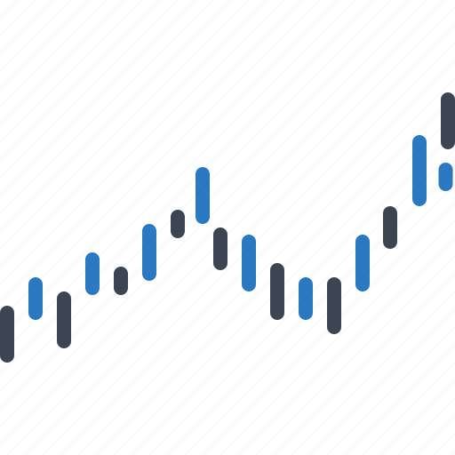
Objective
Forecast interest rates for the first few months of 2025 using historical economic and financial data from the year 1975 to 2024.

Slide 3
Data Collection
idx | Dataset Name | Dataset Link
1 | Federal Funds Effective Rate | https://fred.stlouisfed.org/series/FEDFUNDS
2 | Industrial Production: Total Index | https://fred.stlouisfed.org/series/INDPRO
3 | House Price Index for the United States | https://fred.stlouisfed.org/series/USSTHPI
4 | GDP | https://fred.stlouisfed.org/series/GDP
5 | Personal Consumption Expenditures | https://fred.stlouisfed.org/series/PCE
6 | Unemployment Rate | https://fred.stlouisfed.org/series/UNRATE
7 | USDEUR Exchange Rate | https://fred.stlouisfed.org/series/CCUSMA02EZM618N
8 | Prime Lending Rate | https://fred.stlouisfed.org/series/DPRIME
9 | S&P 500 | https://www.multpl.com/s-p-500-historical-prices/table/by-month

Slide 4
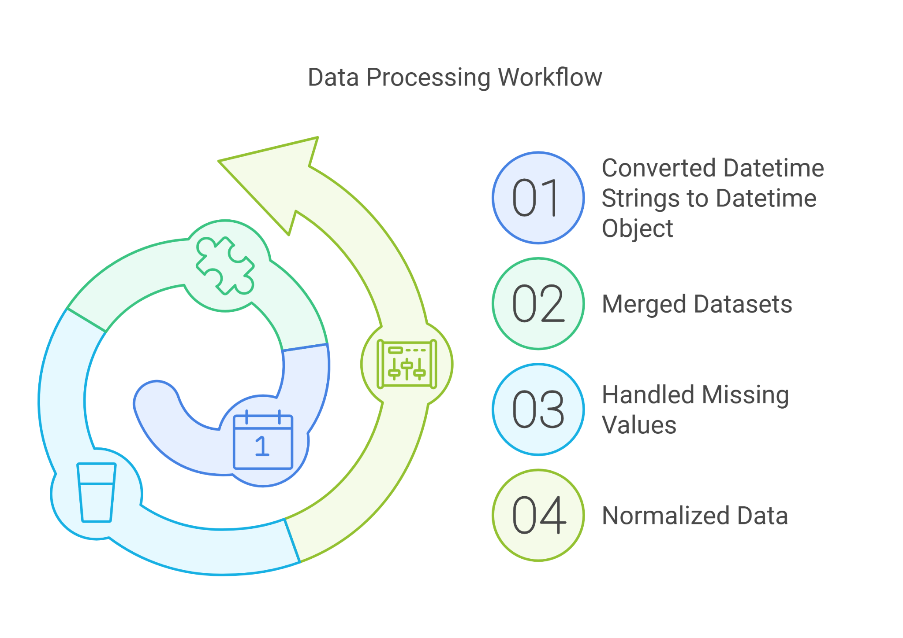
Data Preprocessing

Slide 5
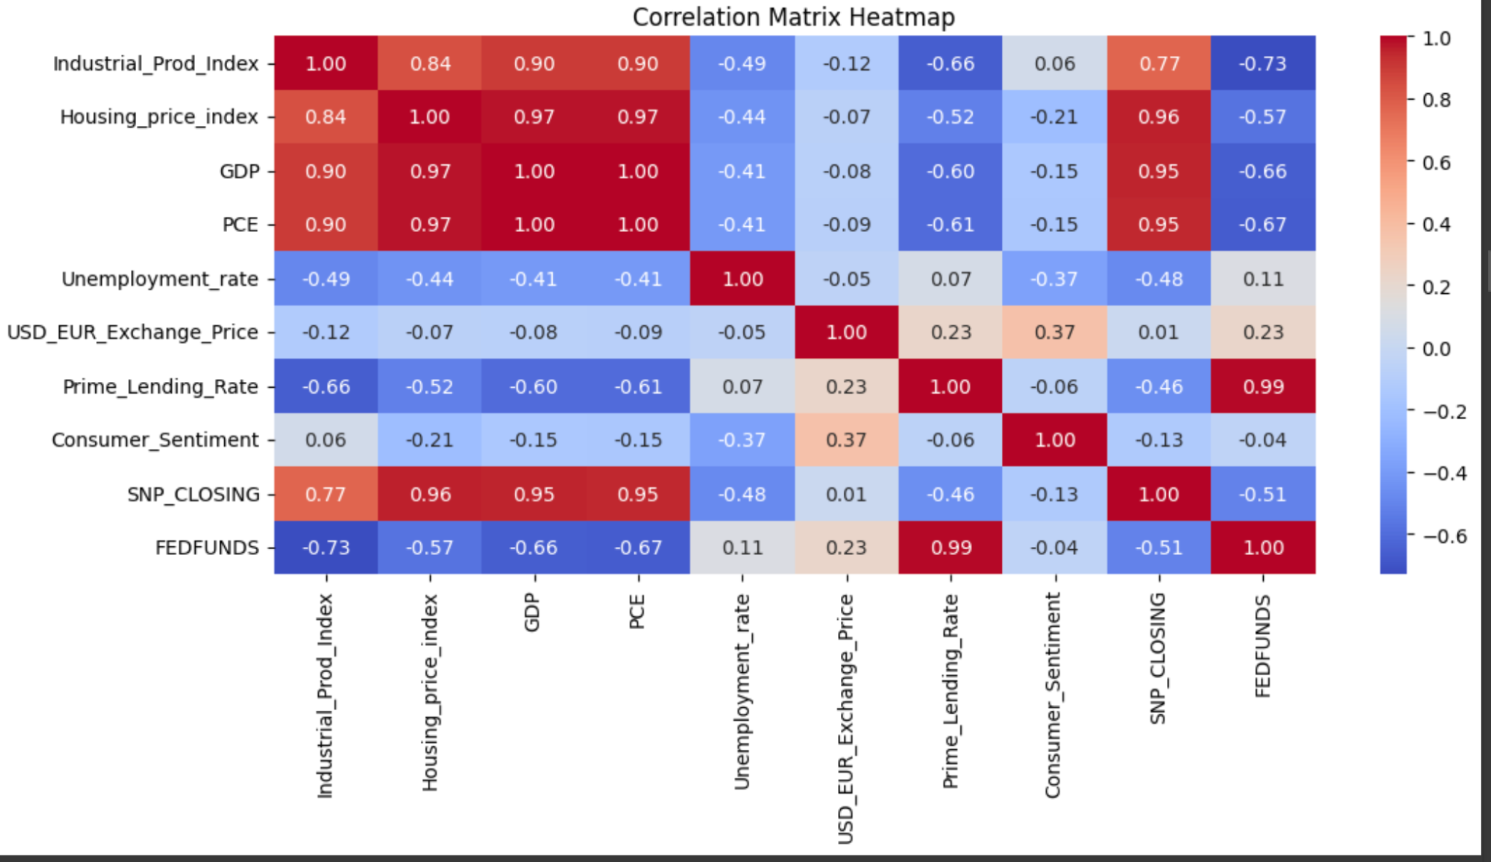
Exploratory Data Analysis
Strong positive correlations exist between GDP, Housing Price Index, Industrial Production Index, and PCE, indicating their interconnected nature.
FED FUNDS shows a significant negative correlation with variables like GDP, PCE and Industrial Prod Index, emphasizing its inverse relationship with economic growth indicators.

Slide 6
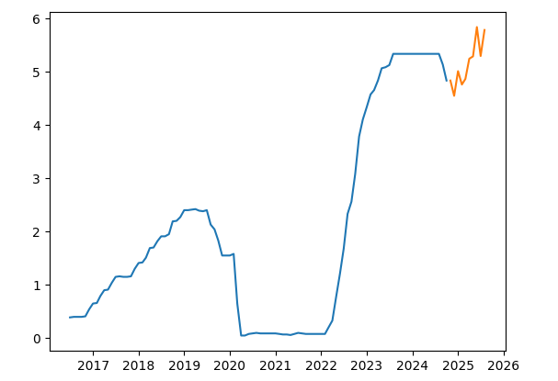
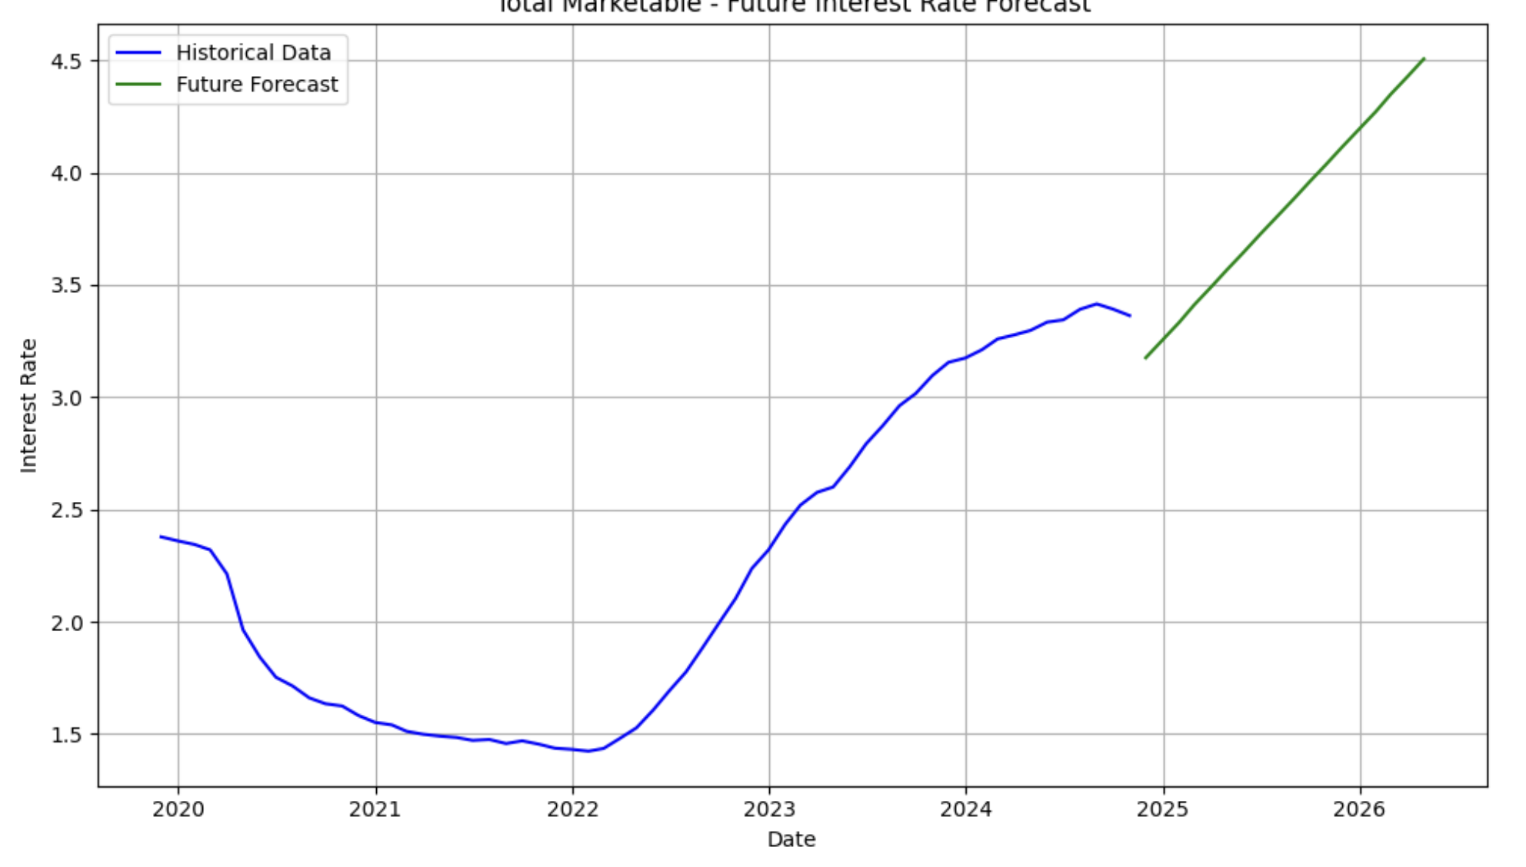
Model Explored
GBM
ARIMA
MSE : 0.068
MSE : 0.1306

Slide 7
Model Selection
LSTM capture temporal dependencies in FEDFUNDS data
Strong Correlations: Prime Lending Rate, GDP, PCE, Industrial Production Index
Linear models unsuitable for sequential relationships.

Slide 8
LSTM Architecture
Input Shape: Sequential data with time steps and features.
First LSTM Layer:
50 units,Outputs a sequence
Second LSTM Layer:
50 units.
Outputs the final hidden state.
Dense Output Layer:
One unit for predicting FEDFUNDS.
Compilation:
Optimizer: Adam (Learning Rate = 0.001).
Loss Function: Mean Squared Error (MSE).

Slide 9
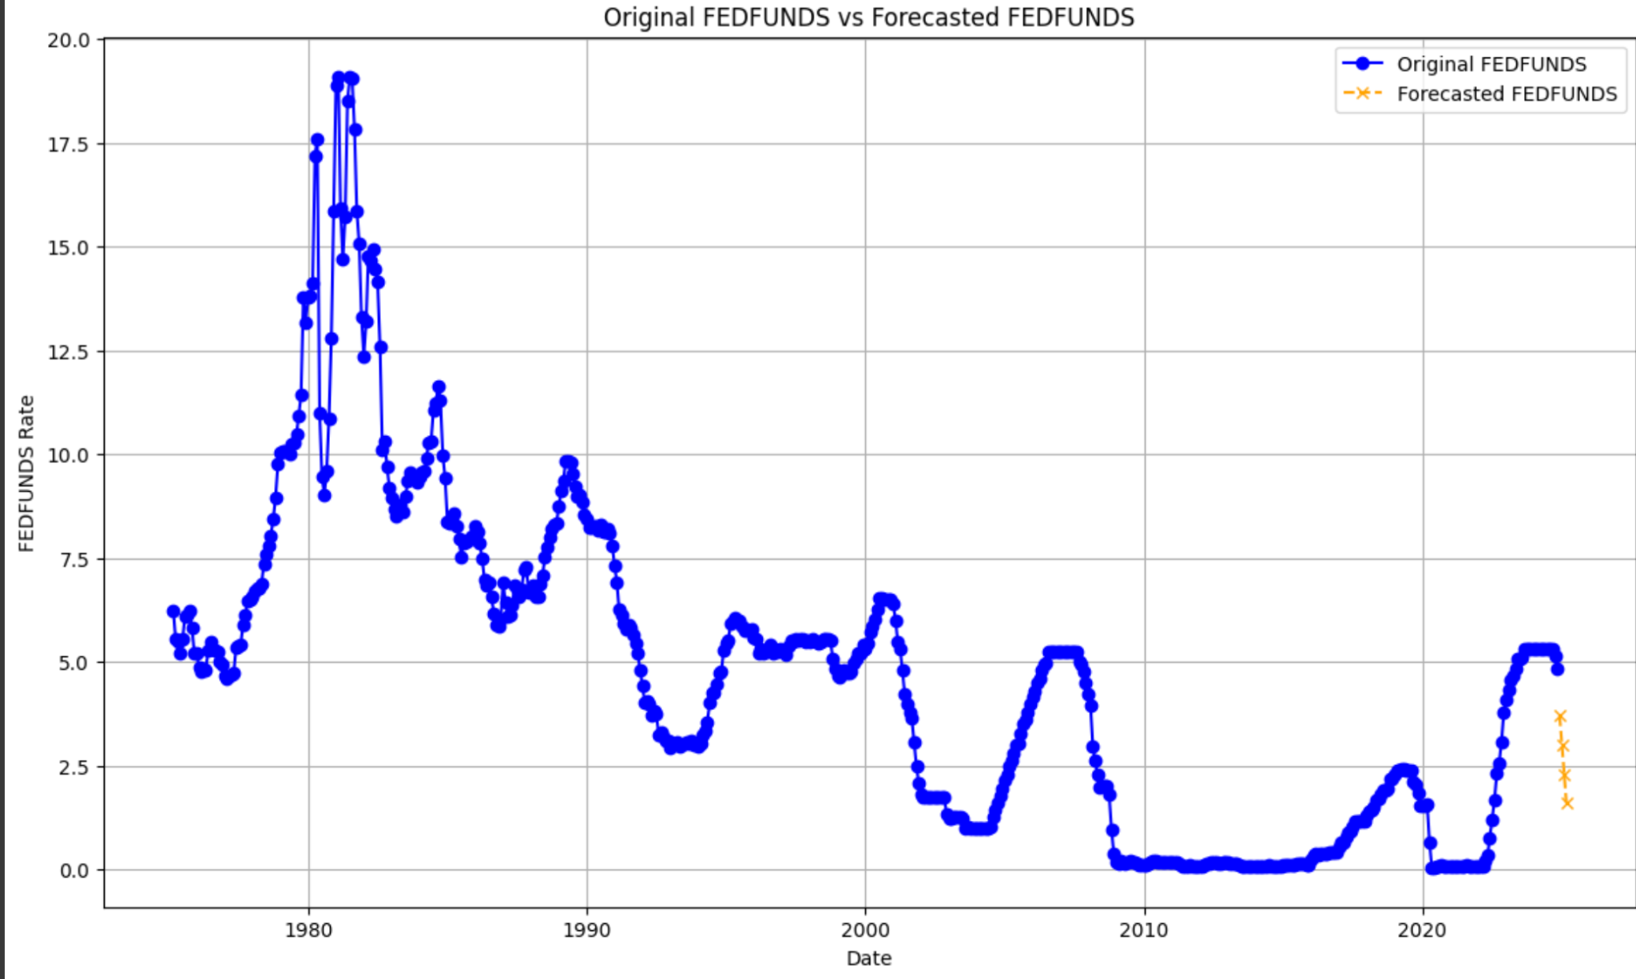
Prediction & Forecast
The forecasted data shows a dip in values for the upcoming months aligning with the recent trends.
MSE: 0.003043346805498004

Slide 10
Thank You!!

